Slide 1

SVM-based Deep Stacking Networks
The Thirty-Third AAAI Conference on Artificial Intelligence Honolulu, Hawaii, USA. January 27–February 1, 2019
Jingyuan Wang, Kai Feng and Junjie Wu
Beihang University, Beijing, China

Slide 2
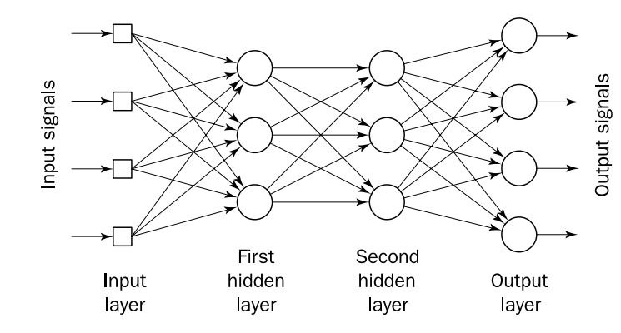
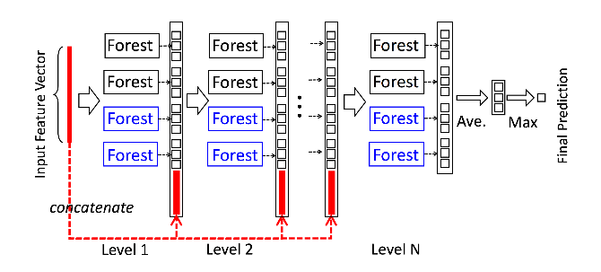
Motivation: How to build a deep network?
Neural Network
Proved to be powerful in numerous tasks
For example: image classification, machine translation, trajectory prediction etc.
Based on other models
The alternative to neural network is worth trying
For example: PCANet (Chan et al. 2015), gcForest (Zhi-Hua Zhou 2017), Deep Fisher Networks (Simonyan, Vedaldi, and Zisserman 2013)
An illustration of the gcForest (Zhi-Hua Zhou 2017)

Slide 3
Related Works
Stacking ensemble
Introduced by Wolpert (Wolpert 1992)
Used in many real-world applications;
Used to integrate strong base-learners (Jahrer et al. 2010)
Researches focused on designing elegant meta-learners (Ting and Witten 1999; Rooney and Patterson 2007; Chen et al. 2014)
Limitation:
Very few works studied how to optimize multi-layer stacked base-learners as a whole.
Performance of the ensemble depends on the diversity of base-learners, which is hard to measure (Sun and Zhou 2018).
Deep Stacking Network frame
Adopted in various applications (Deng et al. 2013; Li et al. 2015; Deng and Yu 2011)
Structure is flexible, thus has mulitple variants (Hutchinson et al 2013; Zhang et al. 2016)
Base blocks could be trained in a parallel way (Deng et al. 2013; Deng and Yu 2011)
Limitation:
Mainly based on neural networks, may be unsatisfactory on interpretability.
Why not use other sorts of base learns, since one layer ANN is not the best shallow learner.

Slide 4

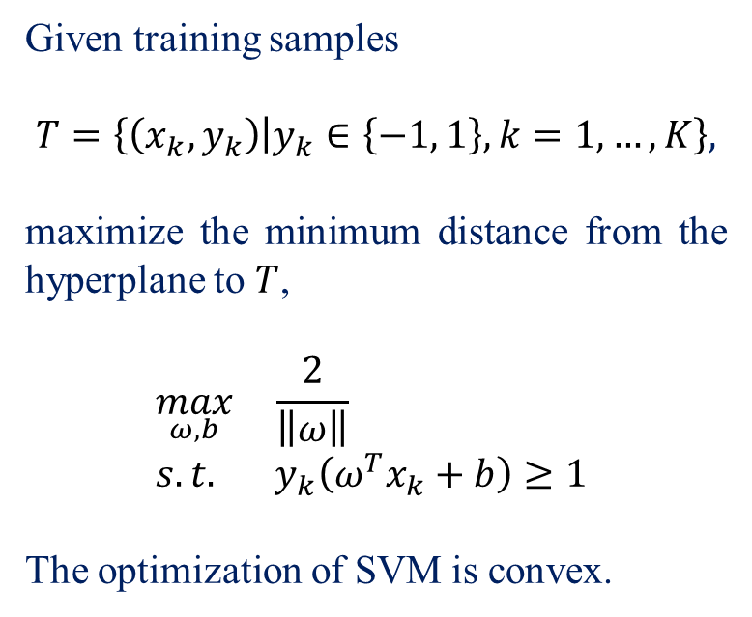



Support Vector Machine
$$ω^{T}x+b=0$$
Given training samples
$$T=\left\{\left(x_{k},y_{k}\right) | y_{k}∈\left\{−1, 1\right\}, k=1,…,K\right\},$$
maximize the minimum distance from the hyperplane to $T$,
$$\max_{ω,b}{ \frac{2}{\left\|ω\right\|}} \\ s.t. y_{k}\left(ω^{T}x_{k}+b\right)≥1$$
The optimization of SVM is convex.
$$H_{1}$$
$$H_{2}$$
$$\frac{2}{\left\|ω\right\|}$$

Slide 5



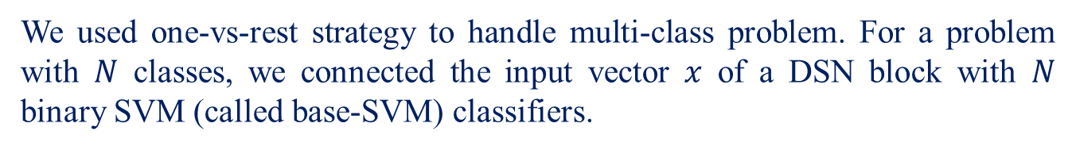



SVM-DSN Block
We used one-vs-rest strategy to handle multi-class problem. For a problem with $N$ classes, we connected the input vector $x$ of a DSN block with $N$ binary SVM (called base-SVM) classifiers.
…
…
…
…
$x$
$$Ω$$
…
…
SVM1
SVM2
SVM $N$
concatenate output of $N$ SVMs
…
$$y$$
Here $Ω =(ω^{\left(1\right)T},ω^{\left(2\right)T},…,ω^{\left(3\right)T})$

Slide 6
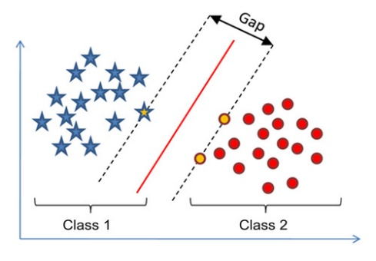

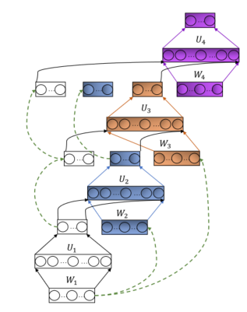
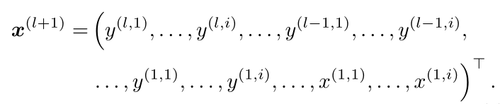
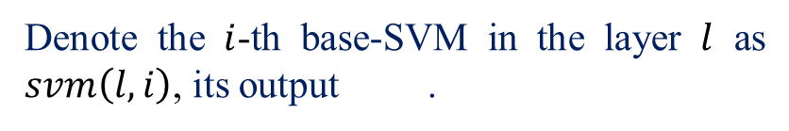
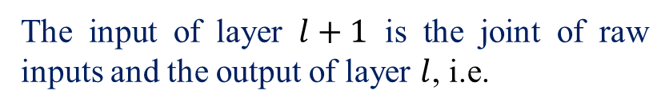
Stacking Blocks
Denote the $i$-th base-SVM in the layer $l$ as $svm\left(l,i\right)$, its output .
SVM Blocks are stacked according to Deep Stacking Network.
SVM
The input of layer $l+1$ is the joint of raw inputs and the output of layer $l$, i.e.
An illustration of the DSN architecture (Deng, He and Gao 2013)

Slide 7
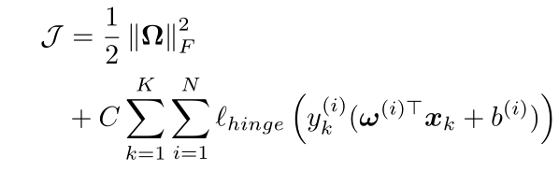

Block Training
The objective function
Efron bootstrap (Efron and Tibshirani 1994) to increase the diversity of base-SVMs.

Slide 8
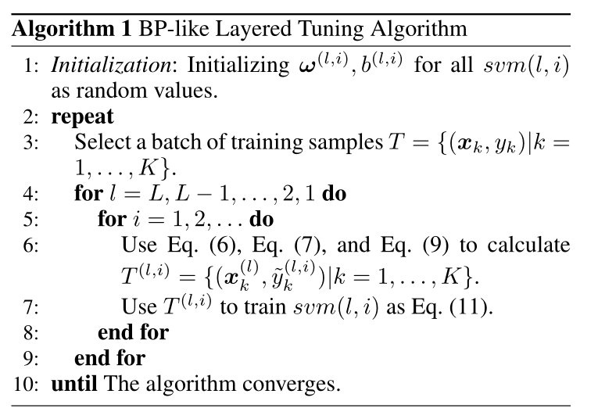
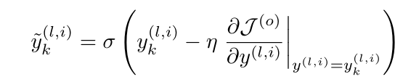
Fine Tuning
BLT: BP-like layered Tuning
Virtual label

Slide 9
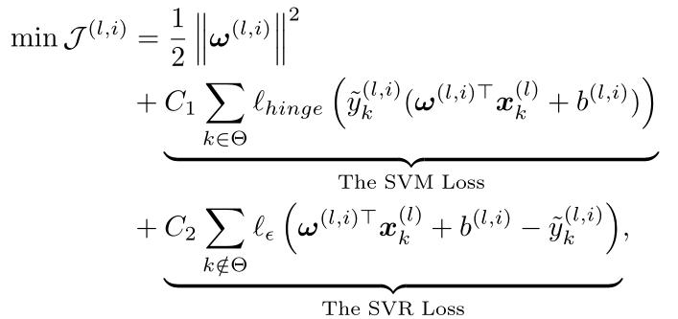
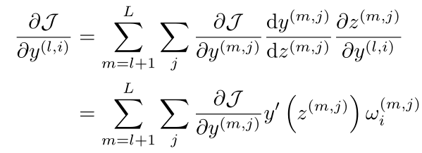
Objective function in fine tuning
SVM&SVR: virtual labels are not guaranteed to be in {-1, 1}. It is still a convex optimization problem.
Recursively calculate the partial derivative.

Slide 10
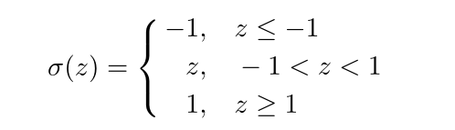
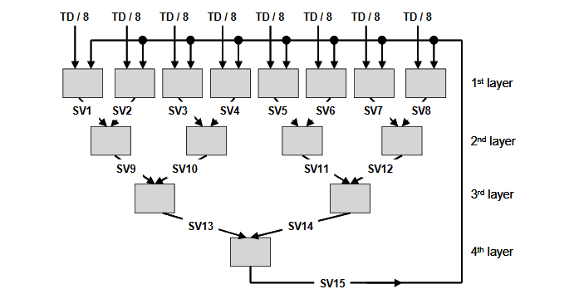
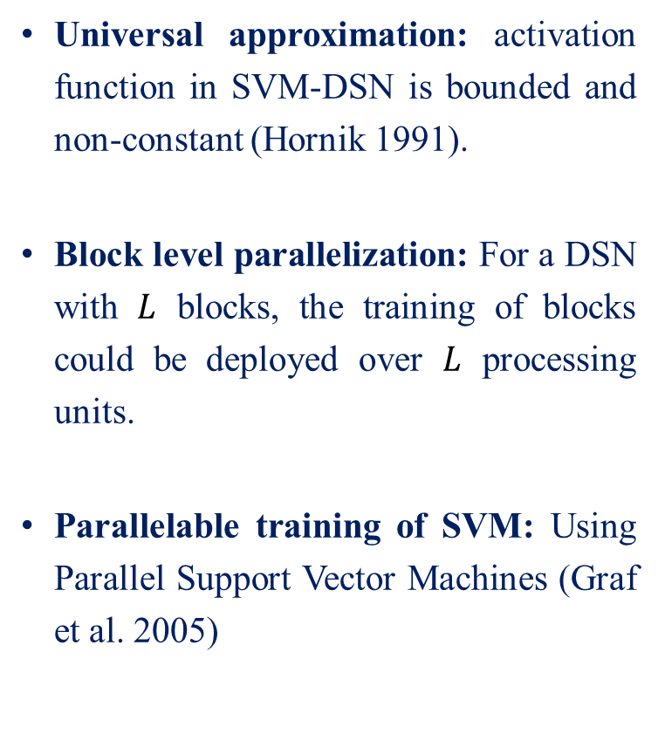
Model Properties
Universal approximation: activation function in SVM-DSN is bounded and non-constant (Hornik 1991).
Block level parallelization: For a DSN with $L$ blocks, the training of blocks could be deployed over $L$ processing units.
Parallelable training of SVM: Using Parallel Support Vector Machines (Graf et al. 2005)
An illustration of the Parallel Support Vector Machines (Graf et al 2005)

Slide 11








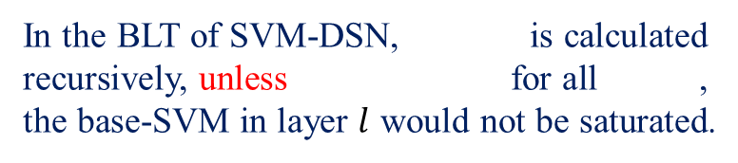
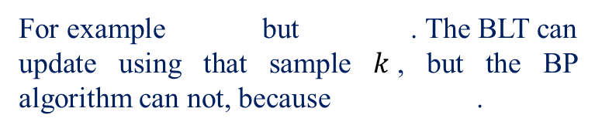
Model Properties
Anti-saturation: the partial derivative for a neuron.
For common activation function like sigmoid and ReLU, can be 0 or near 0 even if there is still much room for the optimization of .
In the BLT of SVM-DSN, is calculated recursively, unless for all , the base-SVM in layer $l$ would not be saturated.
For example but . The BLT can update using that sample $k$, but the BP algorithm can not, because .

Slide 12
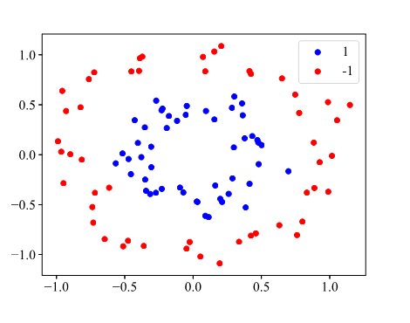
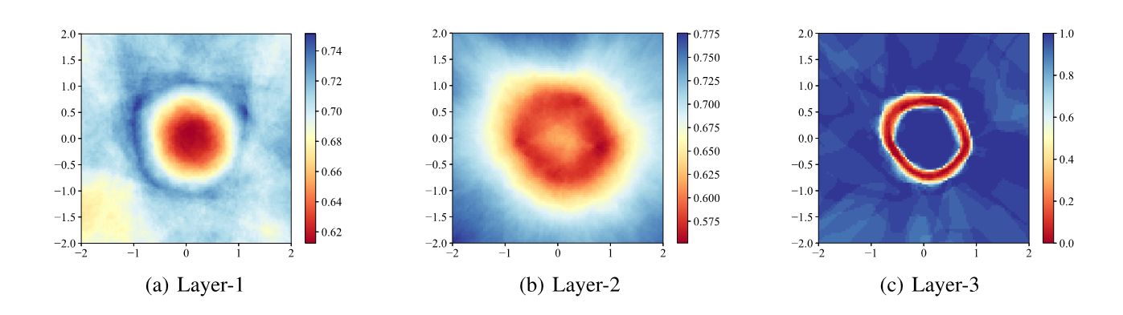
Model Properties
Interpretation: average confidence
The change of “classifying plane” maps illustrate the feature extract process.

Slide 13
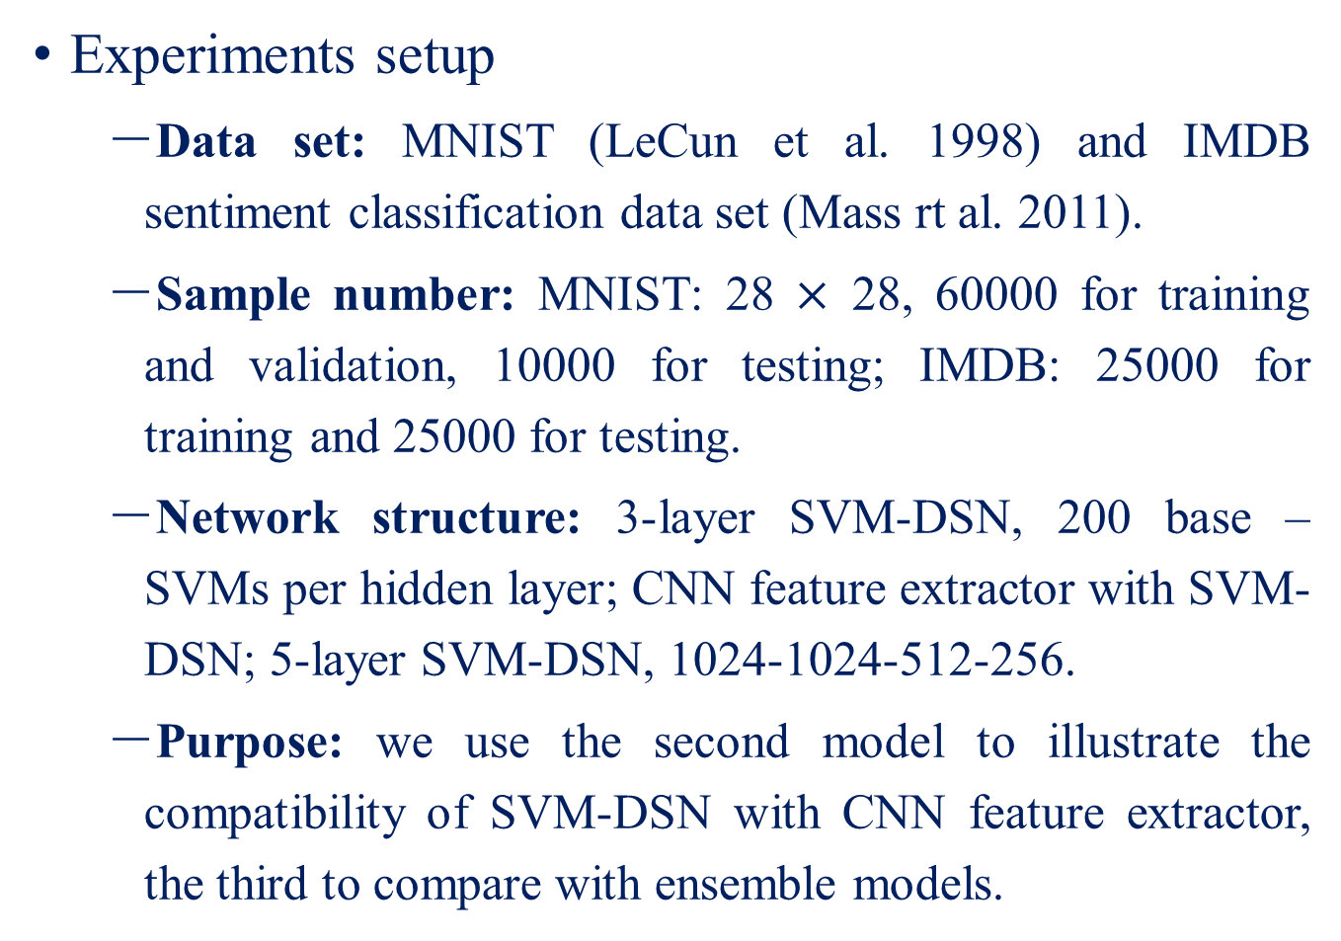
Experiments
Experiments setup
Data set: MNIST (LeCun et al. 1998) and IMDB sentiment classification data set (Mass rt al. 2011).
Sample number: MNIST: 28 $×$ 28, 60000 for training and validation, 10000 for testing; IMDB: 25000 for training and 25000 for testing.
Network structure: 3-layer SVM-DSN, 200 base –SVMs per hidden layer; CNN feature extractor with SVM-DSN; 5-layer SVM-DSN, 1024-1024-512-256.
Purpose: we use the second model to illustrate the compatibility of SVM-DSN with CNN feature extractor, the third to compare with ensemble models.

Slide 14
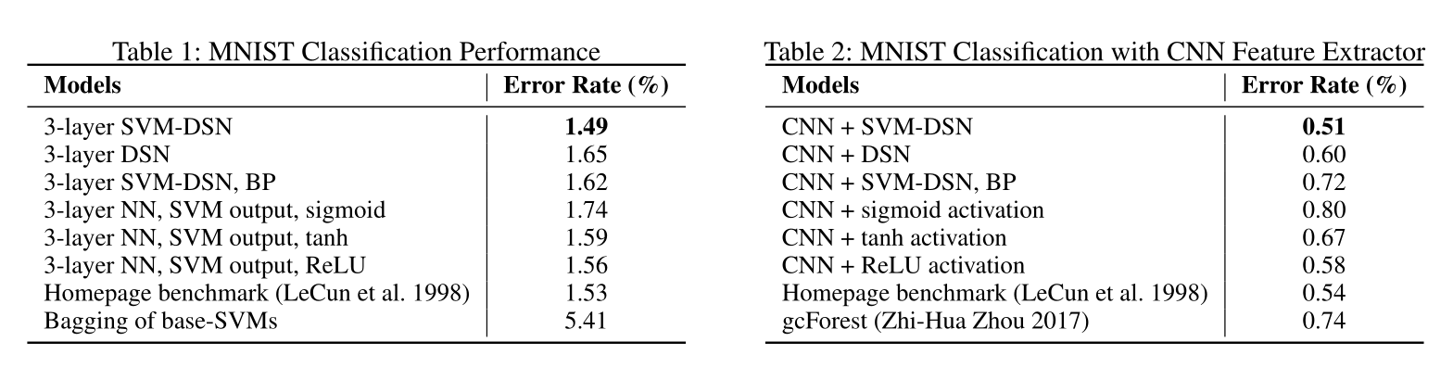
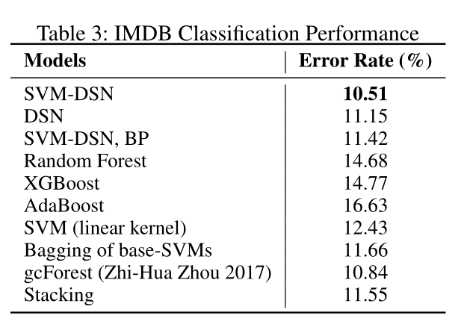
Experiments
Result on MINST
The general scenario
stacking method in
(Perlich and Swirszcz 2011)
is used.

Slide 15
Conclusions
In this paper, we rethink the build of deep network, and present a novel model SVM-DSN.
It can take the advantage of both SVM and DSN: the good mathematical property from SVM and flexible structure from DSN.
As showed in our paper, SVM-DSN has many advantageous properties including optimization and anti-saturation.
The results showed that SVM-DSN is a competitive compare with tradition methods in various scenarios.

Slide 16
Thank You!
Email: fengkai@buaa.edu.cn
Webpage: http://www.bigscity.com/

